Slide 1
Retail Store Sales: Data Exploration & Visualisation
Presented by – Suu Myat noe wai
Tutor name – wong Kim siong
Date – 23 oct, 2026
https://github.com/Suu-mnw/Applied-Data-Science-1

Slide 2
Table of contents
Data Initial Inspection
Data Cleaning and Preparation
Descriptive statistics
Correlation & EDA depth
Visualisation
Trends analysis
Conclusion and Insights

Slide 3
Data Initial Inspection (original dataset)
Transaction dates
0 removed
Around 6,000
Data Types
12575 x 11
Exact Duplicate Rows
Missing counts
Original dataset
Row x columns
Discount Applied col
Outliers

Slide 4
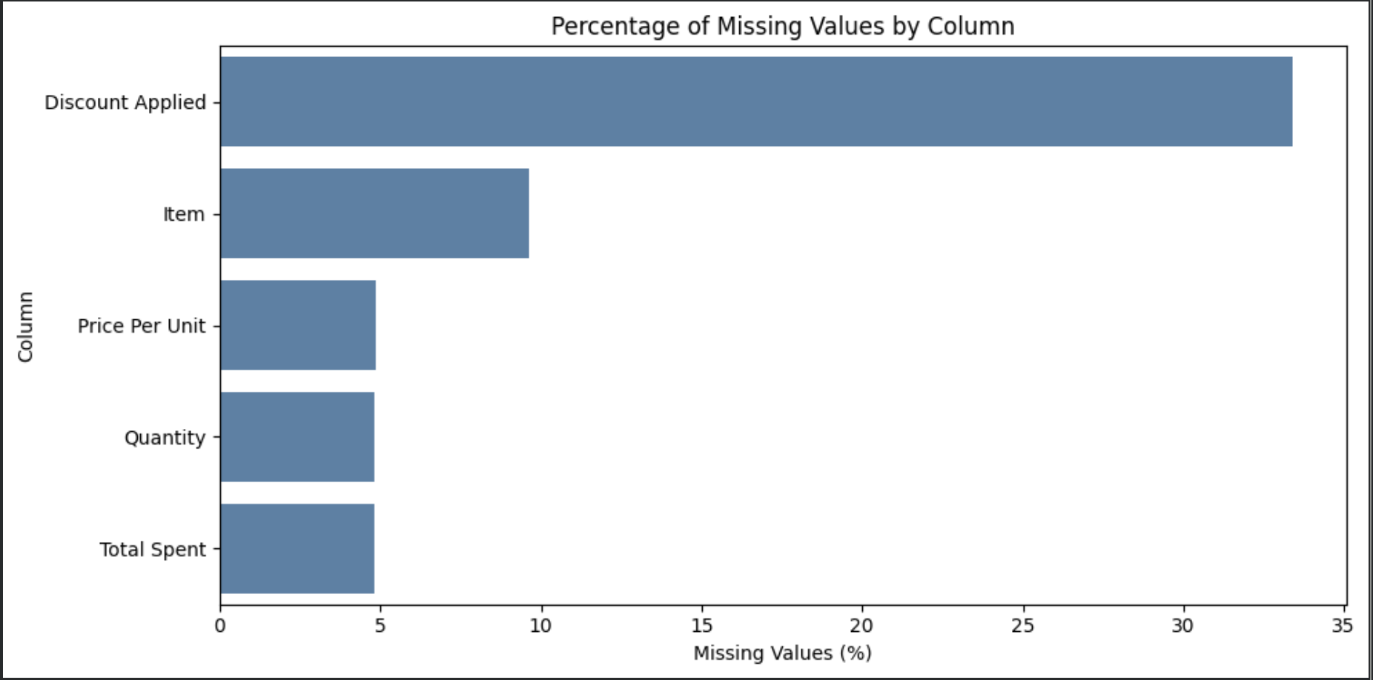
Data Cleaning and Preparation: Missing values

Slide 5
Data Cleaning and preparation
Standardize Texts : Trim spaces; turn empty strings into missing values.
Convert types : Convert price, quantity and spend to numeric; parse transaction dates.
Standardize discount : Map yes/no, true/false and 1/0 to Boolean values.
Check consistency : Remove exact duplicates; calculate missing totals where price and quantity exist.
Flag issues : Create flags for non-positive prices/quantities and possible total mismatches.

Slide 6
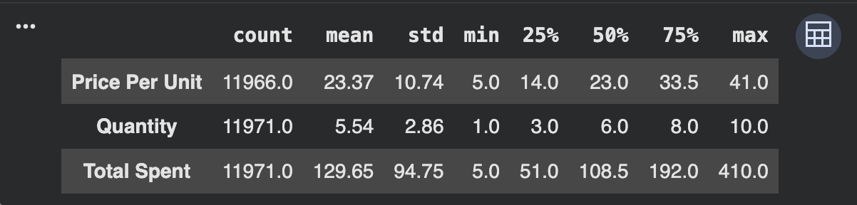
Descriptive Statistics
Mean spending (129.65) is higher than median spending (108.50), suggesting some larger transactions pull the average upward.

Slide 7
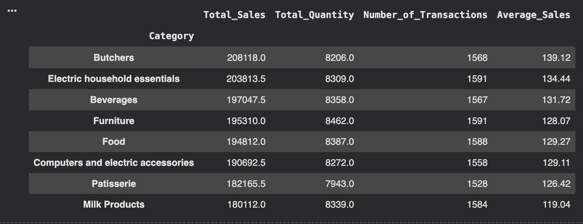
Summerize sales by Categories
describes category sales as balanced, with less than about a 15% gap between the highest and lowest categories.

Slide 8
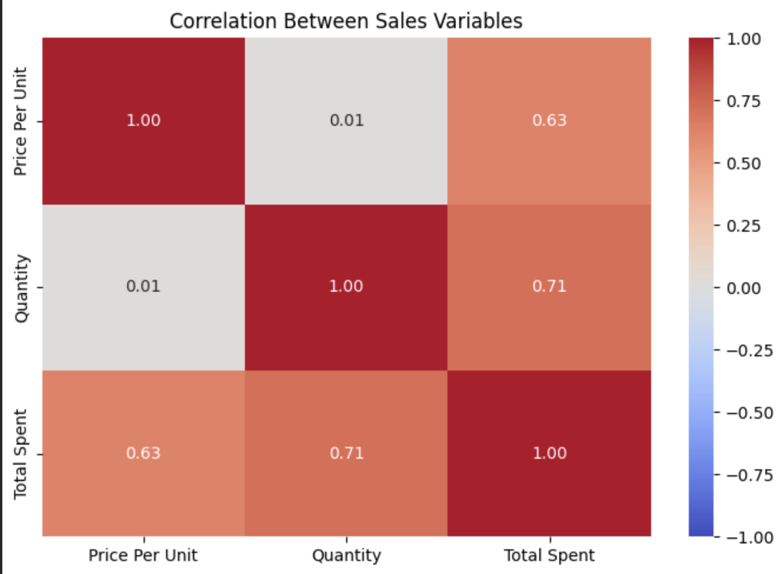
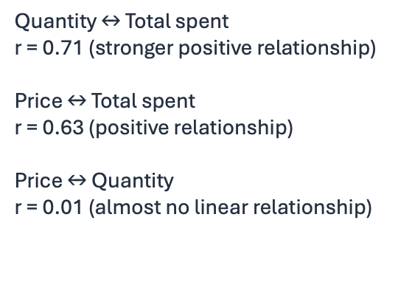
Summerize sales by Categories
Key interpretation

Slide 9
Spending patterns and Outliers
Right-skewed
Positive Trends
Total Spending Distribution
Quantity vs Total Spent
Larger quantities tend to be associated with higher spending.
Most transactions are lower-value; a smaller number are high-value.
The spending distribution has median 108.50 and mean 129.65.
The IQR method flags 60 potential outliers in Total Spent, using an upper bound of 403.50.
Treat flagged values as records to review, not automatically as errors; the maximum reported spend is 410.

Slide 10
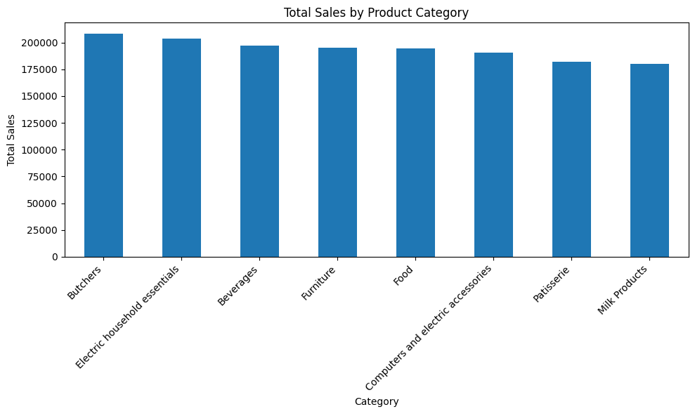
Total sales by Product Categories
Q: Which product categories generate the highest and lowest total sales, and how large are the differences between them?

Slide 11
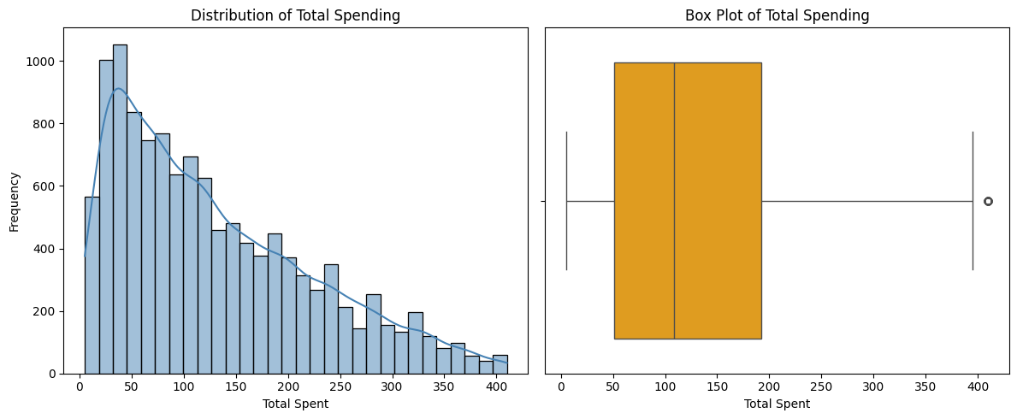
Distribution of Total Spending
Q: How is total spending distributed across transactions, and are there unusually high-spending transactions?

Slide 12
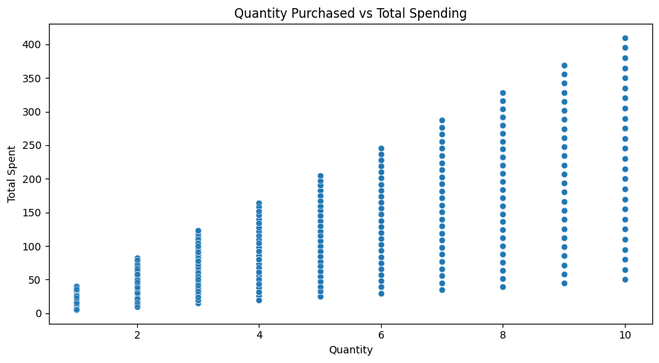
Quantity Purchased vs Total Spending
Q: What is the relationship between the quantity purchased and total transaction spending, and how much variation remains at each quantity?

Slide 13
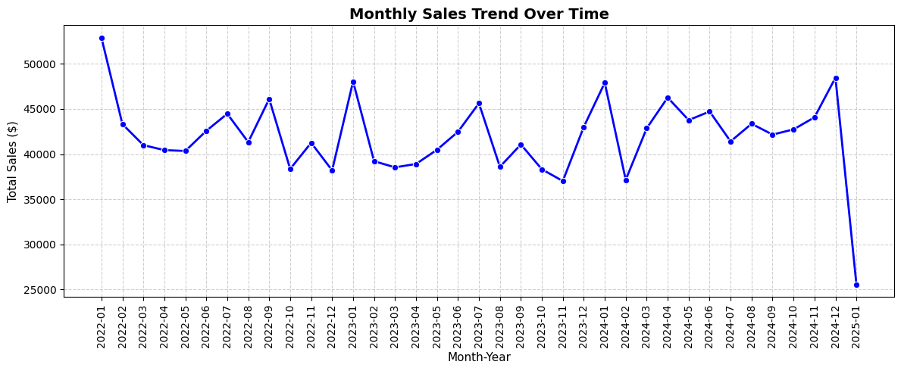
Monthly Sales Trend Over Time
Q: How do monthly total sales change over time, and is the sharp drop in January 2025 explained by incomplete data or a genuine sales change?

Slide 14
Conclusion and Insights
If the business maintains sales in its stronger categories, attracts repeat customers, and increases spending per transaction, sales could grow.

Slide 15
Thank You
Any Questions?

